Slide 1
Module 6
Clustering and Pathway Analysis

Slide 2
Outline
Introduction to module
Clustering overview
Overview of clustering methods
Similarity assessment
Clustering methods
Clustering with KMeans
Density based clustering
Hierarchical clustering
Pathway analysis
Pathway analysis overview
Pathway discovery
Pathway visualization
Clustering and biological pathways with R
R scripts to find clusters and pathways

Slide 3
Learning Objectives
Find clusters in biomedical data involving genes.
Analyze and visualize biological pathways.
2. Write R scripts for clustering and for pathway analysis.

Slide 4
Introduction to Module
This module studies the most important topic of gene clustering and pathway analysis.
Given the vast amounts of genetic data available, it is particularly interesting to summarize them, find homogeneous subgroups, called clusters, and learn the biological pathways underlying regulatory networks.
We will study different ways to find clusters in genetic data and will see some examples of pathway analysis.
R provides many useful functions for clustering and pathway analysis.

Slide 5
Outline
Introduction to module
Clustering overview
Overview of clustering methods
Similarity assessment
Clustering methods
Clustering with KMeans
Density based clustering
Hierarchical clustering
Pathway analysis
Pathway analysis overview
Pathway discovery
Pathway visualization
Clustering and biological pathways with R
R scripts to find clusters and pathways

Slide 6
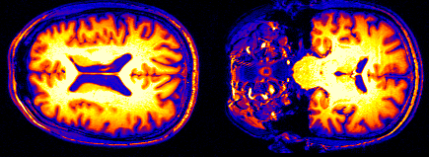
Clustering Overview
A cluster is a group of data within a dataset.
Clustering analysis is closely related to pattern recognition.
Clustering aims at finding clusters in which the objects are
As similar as possible to other objects in the same cluster.
As different as possible to objects in the other clusters.
Clustering is an unsupervised data analytics task because the clusters are not known in advance – they have to be discovered automatically.

Slide 7
Clustering Overview
Machine Learning
Supervised Learning
Unsupervised Learning
Classification
Prediction
Regression
SVM, ANN, kNN, DT, BN, …
SVM, ANN, kNN, DT, BN, …
Clustering
Pathway Analysis

Slide 8
Outline
Introduction to module
Clustering overview
Overview of clustering methods
Similarity assessment
Clustering methods
Clustering with KMeans
Density based clustering
Hierarchical clustering
Pathway analysis
Pathway analysis overview
Pathway discovery
Pathway visualization
Clustering and biological pathways with R
R scripts to find clusters and pathways

Slide 9
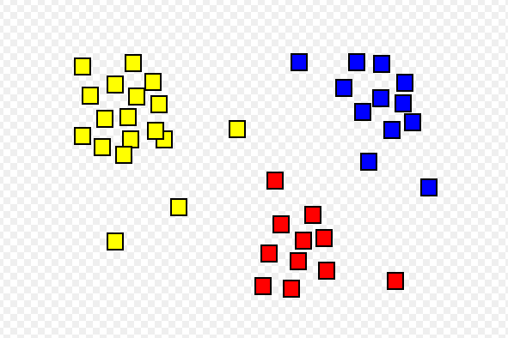
Overview of Clustering Methods
Clustering is a search problem aiming at finding homogeneous subgroups of objects, aiming at:
Maximizing the overall similarity of objects within each cluster – intra-class similarity.
Minimizing the overall similarity of objects between clusters – called inter-class similarity.
One way to calculate these similarities is to add individual distances in each category after squaring them.

Slide 10

Overview of Clustering Methods
Clustering performance measures:
Understandability.
Scalability.
Ability to discover clusters of any shape (not only circular).
Ability to cluster heterogeneous data (of different types).
Robustness to noise.
Robustness to outliers.
etc.

Slide 11
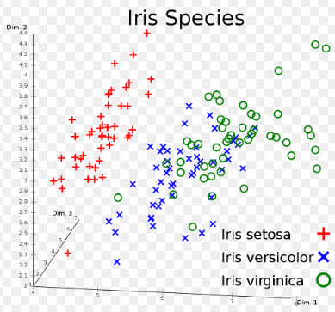
Overview of Clustering Methods
Clustering examples in bioinformatics:
Cluster gene expressions to find groups of people with similar profiles – then compare with diagnostic categories or other data in these people’s files.
Within a diagnostic category, group patients into subgroups.
Detect patterns of evolution in the genome – between species, and within individuals of the same species. Connect these patterns with characteristics of species / individuals /patients.

Slide 12
Outline
Introduction to module
Clustering overview
Overview of clustering methods
Similarity assessment
Clustering methods
Clustering with KMeans
Density based clustering
Hierarchical clustering
Pathway analysis
Pathway analysis overview
Pathway discovery
Pathway visualization
Clustering and biological pathways with R
R scripts to find clusters and pathways

Slide 13
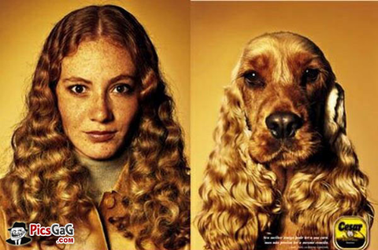
Similarity Assessment
Similarity measures the opposite of distance: high similarity = low distance low similarity = high distance.
Normalization is usually applied before calculating similarity so that variables are within the same scale.
Distance between:
numeric variables
nominal variables
ordinal variables
mixed types of variables.

Slide 14
Similarity Assessment
Distance between numeric variables:
Euclidean distance
Any distance function can be used (a distance is a mathematical function with following properties:
d(i,j) ≥ 0
d(i,i) = 0
d(i,j) = d(j,i)
d(i,j) ≤ d(i,k) + d(k,j) (Pythagorean theorem)
).
We can also use correlation coefficient or any other measure of dissimilarity.
J (x_{j1}, x_{j2})
I (x_{i1}, x_{i2})
d

Slide 15
Similarity Assessment
Distance between nominal variables:
For binary variables: if symmetric binary variables
if asymmetric binary variables (Jaccard coefficient)
For non-binary, d(I, j) = #mismatches / #variables
Object j
Object i

Slide 16
Similarity Assessment
Distance between ordinal variables:
Ordinal variables can be processed as
first map each value into a number: a → 1, b → 2, etc.
then calculate distance as for a numeric variable (1 < 2 < 3 …).

Slide 17
Similarity Assessment
Distance between mixed types variables:
Add all the respective distances according to the types present in the object.
Ultimately a final distance is calculated over all the objects.

Slide 18
Outline
Introduction to module
Clustering overview
Overview of clustering methods
Similarity assessment
Clustering methods
Clustering with KMeans
Density based clustering
Hierarchical clustering
Pathway analysis
Pathway analysis overview
Pathway discovery
Pathway visualization
Clustering and biological pathways with R
R scripts to find clusters and pathways

Slide 19
Clustering Methods
Partitioning approach:
Construct various partitions and then evaluate them by some criterion, e.g., minimizing the sum of square errors
Typical method: KMeans.
Density-based approach:
Based on connectivity and density functions
Typical method: DBSCAN.
Hierarchical approach:
Create a hierarchical decomposition of the set of data (or objects) using some criterion
Typical method: DIANA.

Slide 20
Outline
Introduction to module
Clustering overview
Overview of clustering methods
Similarity assessment
Clustering methods
Clustering with KMeans
Density based clustering
Hierarchical clustering
Pathway analysis
Pathway analysis overview
Pathway discovery
Pathway visualization
Clustering and biological pathways with R
R scripts to find clusters and pathways

Slide 21
Clustering with KMeans
Algorithm proceeds in several steps. Suppose that we want to create 2 clusters.
Step 1: We first create two separate clusters and assign arbitrarily a center object (red point) – called centroid. From Han and Kamber
10
9
8
7
6
5
4
3
2
1
0
0
1
2
3
4
5
6
7
8
9
10

Slide 22
Clustering with KMeans
Step 2: We assign each object to the cluster formed around each centroid.

Slide 23
Clustering with KMeans
Repeat Step 1: We calculate the centroid in each cluster.
10
9
8
7
6
5
4
3
2
1
0
0
1
2
3
4
5
6
7
8
9
10

Slide 24
Clustering with KMeans
Repeat Step 2: We assign each object to the cluster formed around each centroid. We continue until the clusters do not change.

Slide 25
Clustering with KMeans
Advantage
Efficient method.
Improved by Partitioning Around Medoids (PAM).
Drawbacks
The number of clusters is fixed – however there are methods that find this number automatically.
Clusters have convex shape.
It is sensitive to outliers.

Slide 26
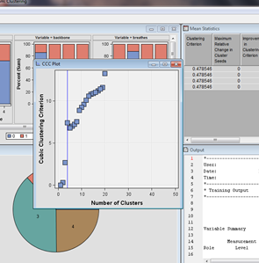
Clustering with KMeans
The Ward algorithm determines the optimal number of clusters by choosing the first value of K where the Cubic Clustering Criterion (CCC) goes from increasing to decreasing.

Slide 27
Outline
Introduction to module
Clustering overview
Overview of clustering methods
Similarity assessment
Clustering methods
Clustering with KMeans
Density based clustering
Hierarchical clustering
Pathway analysis
Pathway analysis overview
Pathway discovery
Pathway visualization
Clustering and biological pathways with R
R scripts to find clusters and pathways

Slide 28
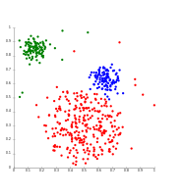
Density Based Clustering
Density-based clustering forms clusters according to the density of objects in regions.
DBSCAN is the most famous example.
Advantage:
It looks for clusters of any shape.
It is little sensitive to outliers or noise.
It is efficient.

Slide 29
Density Based Clustering
Outlier
Border
Eps = 1cm
MinPts = 5
Core
From Han and Kamber

Slide 30
Outline
Introduction to module
Clustering overview
Overview of clustering methods
Similarity assessment
Clustering methods
Clustering with KMeans
Density based clustering
Hierarchical clustering
Pathway analysis
Pathway analysis overview
Pathway discovery
Pathway visualization
Clustering and biological pathways with R
R scripts to find clusters and pathways

Slide 31
Hierarchical Clustering
This method can find any number of clusters and organizes them in a tree with sub-clusters.
The tree is called a dendrogram.
It is the representation of evolutionary trees.

Slide 32
Hierarchical Clustering
There are two main methods – divisive and agglomerative.
Step 0
Step 1
Step 2
Step 3
Step 4
agglomerative
(AGNES)
a
a b
b
a b c d e
c
c d e
d
d e
e
divisive
(DIANA)
Step 4
Step 3
Step 2
Step 1
Step 0

Slide 33
Hierarchical Clustering
Hierarchical clustering has many applications in bioinformatics, and particularly in phylogenetic classification in which species are organized along a tree – the tree of life.

Slide 34
Outline
Introduction to module
Clustering overview
Overview of clustering methods
Similarity assessment
Clustering methods
Clustering with KMeans
Density based clustering
Hierarchical clustering
Pathway analysis
Pathway analysis overview
Pathway discovery
Pathway visualization
Clustering and biological pathways with R
R scripts to find clusters and pathways

Slide 35
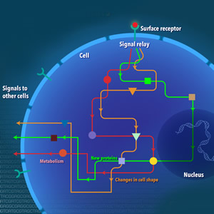
Pathway Analysis
Pathways are more complex structures than clusters.
A biological pathway corresponds to a series of actions among molecules in a cell that leads to a certain product or change.
For example, a pathway can result in the formation of a particular protein, or can turn a gene on or off.
Biological pathways may be mostly: metabolic, genetic, or signal transduction.
From National Human Genome Research Institute

Slide 36
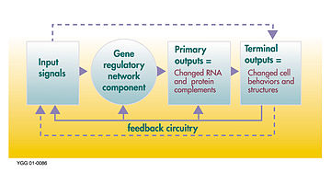
Pathway Analysis
In comparison a gene regulatory network (GRN) may involve multiple pathways also called gene regulation pathways.
A GRN has for effect to increase or decrease the production of mRNA from a particular gene, set of genes, or the corresponding protein(s).
It is very important for treatment to determine the pathways involved in disease progression as to find cures (ex: CML).

Slide 37
Outline
Introduction to module
Clustering overview
Overview of clustering methods
Similarity assessment
Clustering methods
Clustering with KMeans
Density based clustering
Hierarchical clustering
Pathway analysis
Pathway analysis overview
Pathway discovery
Pathway visualization
Clustering and biological pathways with R
R scripts to find clusters and pathways

Slide 38
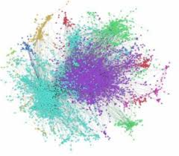
Pathway Analysis Overview
Complex systems are composed of many elements interacting with one another.
Interactions are frequent so that the system changes and reorganizes based on these.
Even small changes in the system can cause important changes in the whole system.
Complex systems researchers need tools to represent and understand their functioning.

Slide 39
Pathway Analysis Overview
Pathway analysis focuses mainly on:
Gene set enrichment analysis which aims at mapping genes being upregulated or downregulated to higher level structures such as biological pathways and gene regulatory networks. They can start from differentially expressed genes and linking them to neighboring genes and pathways.
Causal discovery which aims at building pathways and networks from data, and testing network structure hypothesis.

Slide 40
Pathway Analysis Overview
Ultimately the goal is to move from biological pathways to gene regulatory networks.
Gene transcription depends on
Trans regulatory circuits:
The trans-regulatory circuit is considered as the regulatory interactions between upstream regulatory genes and transcription factor binding site motifs or cis elements → transcription factors.
Cis-regulatory circuit:
The cis-regulatory circuit can be viewed as a dynamic interactive circuit among binding site motifs with their effective action on the expression scheme of the target gene → binding site motifs.
Another mechanism is to add/remove genes to/from a network to change its behavior.

Slide 41
Pathway Analysis Overview
Next step in genomics: assemble functional components of genomes and cells into the circuits that transform signals into cellular responses.
Two approaches:
Small-scale approaches develop detailed quantitative models of the regulatory circuits controlling one or very few genes.
Large-scale approaches use computational algorithms to reconstruct genome-scale circuits.
They are likely to merge to produce genome-wide models.

Slide 42
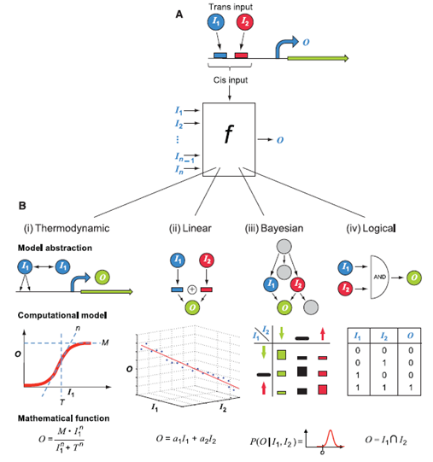
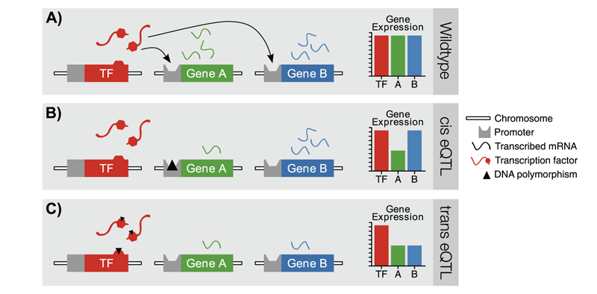
Pathway Analysis Overview
(Kim et al. 2009)
(Wolen et al.)

Slide 43
Outline
Introduction to module
Clustering overview
Overview of clustering methods
Similarity assessment
Clustering methods
Clustering with KMeans
Density based clustering
Hierarchical clustering
Pathway analysis
Pathway analysis overview
Pathway discovery
Pathway visualization
Clustering and biological pathways with R
R scripts to find clusters and pathways

Slide 44
Pathway Discovery
A large number of pathways is already known and can be retrieved from databases:
KEGG (Kyoto Encyclopedia of Genes and Genomes) has known 494 pathways.
It has both healthy pathways and disease-specific pathways.
Fee-based however the previous version is freely available.

Slide 45
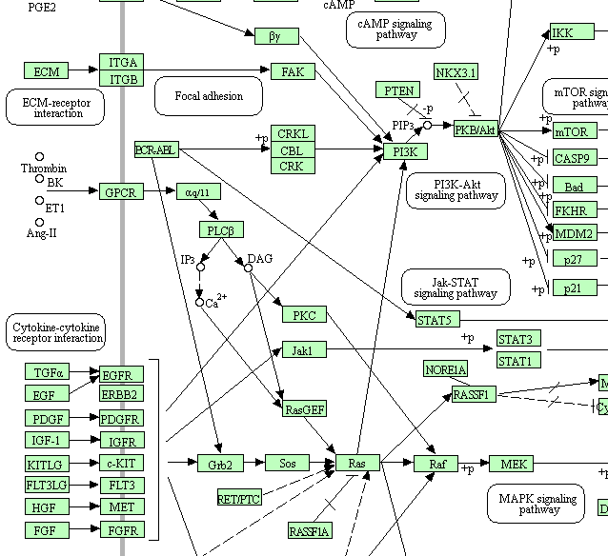
Pathway Discovery
pathways in cancer
(www.genome.jp/kegg/)

Slide 46
Pathway Discovery
Pathway enrichment uses known pathways from a pathway database and links them to differentially expressed genes.
Pathway databases such as KEGG, REACTOME, BIOCARTA etc. are used to map differentially expressed genes.
The association between these genes and pathways is quantified to statistically determine which pathways are significantly involved.
Main methods involved:
Causal discovery.
De-convolution methods.
Metabolomics.

Slide 47
Pathway Discovery
Graphical models support causal discovery and the creation of models linking gene alterations, gene expression data, and other types of data (clinical, environmental, metabolomics etc.).
Ex: Tetrad (http://www.phil.cmu.edu/tetrad/).
SGA₁
SGA₂
SGA₂
SGA₃
DEG₁
DEG₂
DEG₃
DEG₄
DEG₅
DEG₆

Slide 48
Outline
Introduction to module
Clustering overview
Overview of clustering methods
Similarity assessment
Clustering methods
Clustering with KMeans
Density based clustering
Hierarchical clustering
Pathway analysis
Pathway analysis overview
Pathway discovery
Pathway visualization
Clustering and biological pathways with R
R scripts to find clusters and pathways

Slide 49
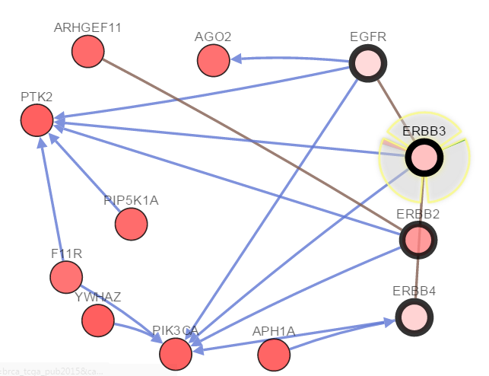
Pathway Visualization
cBioPortal (http://www.cbioportal.org).

Slide 50
Pathway Visualization
cBioPortal network functionality:
Screen genes shown by percentage of alteration.
Interaction data and pathway data come from multiple pathway databases (REACTOME. NCI Pathway Interaction Database, etc.).
Additional interactions can be shown such as drugs.
Two types of nodes:
Seed nodes represent the genes in the user query.
Linker nodes are genes linked to seed nodes in known pathways.

Slide 51
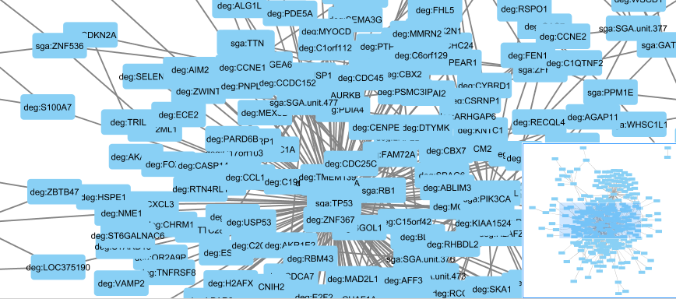
Pathway Visualization
Cytoscape (http://www.cytoscape.org/).

Slide 52
Outline
Introduction to module
Clustering overview
Overview of clustering methods
Similarity assessment
Clustering methods
Clustering with KMeans
Density based clustering
Hierarchical clustering
Pathway analysis
Pathway analysis overview
Pathway discovery
Pathway visualization
Clustering and biological pathways with R
R scripts to find clusters and pathways

Slide 53
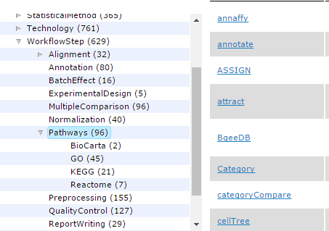
Clustering and Biological Pathways with R
R packages for
datasets (contains a number of datasets such as iris etc.)
Clustering (https://cran.r-project.org/web/views/Cluster.html)
Partitioning (cluster, etc.)
Density-based (dbscan, densityCut, etc.)
Hierarchical (cluster, etc.)
Pathway analysis (http://bioconductor.org/packages/release/BiocViews.html#___Pathways)
KEGGgraph
ROntoTools
ReactomePA
iPathwayGuide
etc.

Slide 54
Outline
Introduction to module
Clustering overview
Overview of clustering methods
Similarity assessment
Clustering methods
Clustering with KMeans
Density based clustering
Hierarchical clustering
Pathway analysis
Pathway analysis overview
Pathway discovery
Pathway visualization
Clustering and biological pathways with R
R scripts to find clusters and pathways

Slide 55
R Scripts for Find Clusters and Pathways
Start Jupyter notebook from the provided link

